Slide 1
CHAPTER 1
Introduction

Slide 2
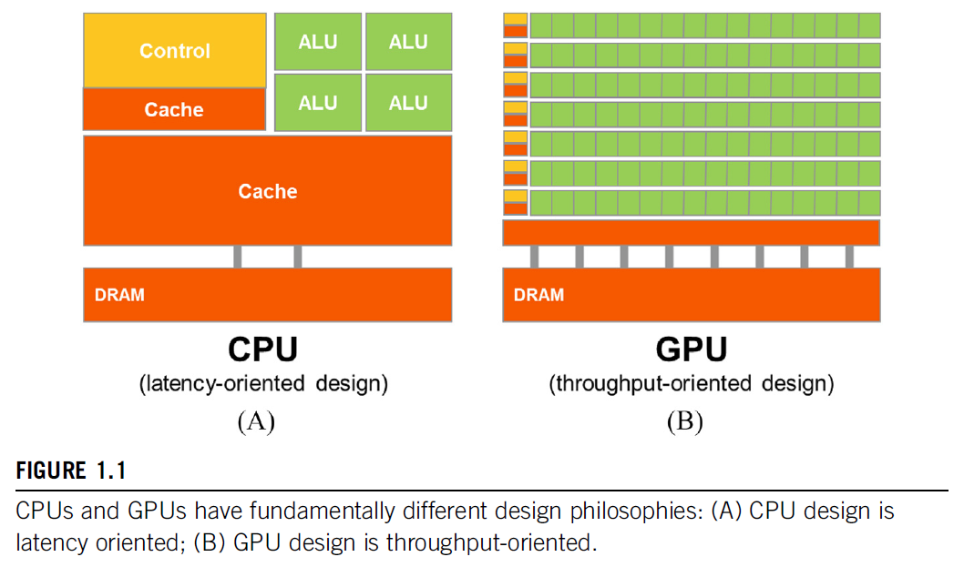

Slide 3
